Slide 1


CI/CD ASSIGNMENT
Presented By : DEEKSHA TRIPATHI

Slide 2
AGENDA
Create a Jenkins pipeline to deploy application present at: https://github.com/knoldus/node-hello
Required command to run the application and the ports being used are present in the Github repository.
You are required to use Jenkins Freestyle project to set this pipeline.
Requirements:
Jenkins should be set up on a Cloud Virtual Machine and not from the local system
Any commits to the ‘main’ branch should trigger the job on Jenkins and start the build process
Use Poll SCM triggers
The first part of the Jenkins job should be creating the package
The second part of the Jenkins job will be to send the package to another VM and run it there
The validations can be performed by hitting endpoints: <VM_IP>:3000 or <VM_IP>:3001

Slide 3


INTRODUCTION
Tools & Technologies
In this we used :
Amazon AWS
Jenkins
Amazon AWS: AWS (Amazon Web Services) is a comprehensive, evolving cloud computing platform provided by Amazon that includes a mixture of infrastructure as a service (IaaS), platform as a service (PaaS) and packaged software as a service (SaaS) offerings.
Jenkins: Jenkins is an open-source automation tool written in Java with plugins built for Continuous Integration purposes. Jenkins is used to build and test your software projects continuously making it easier for developers to integrate changes to the project, and making it easier for users to obtain a fresh build.

Slide 4
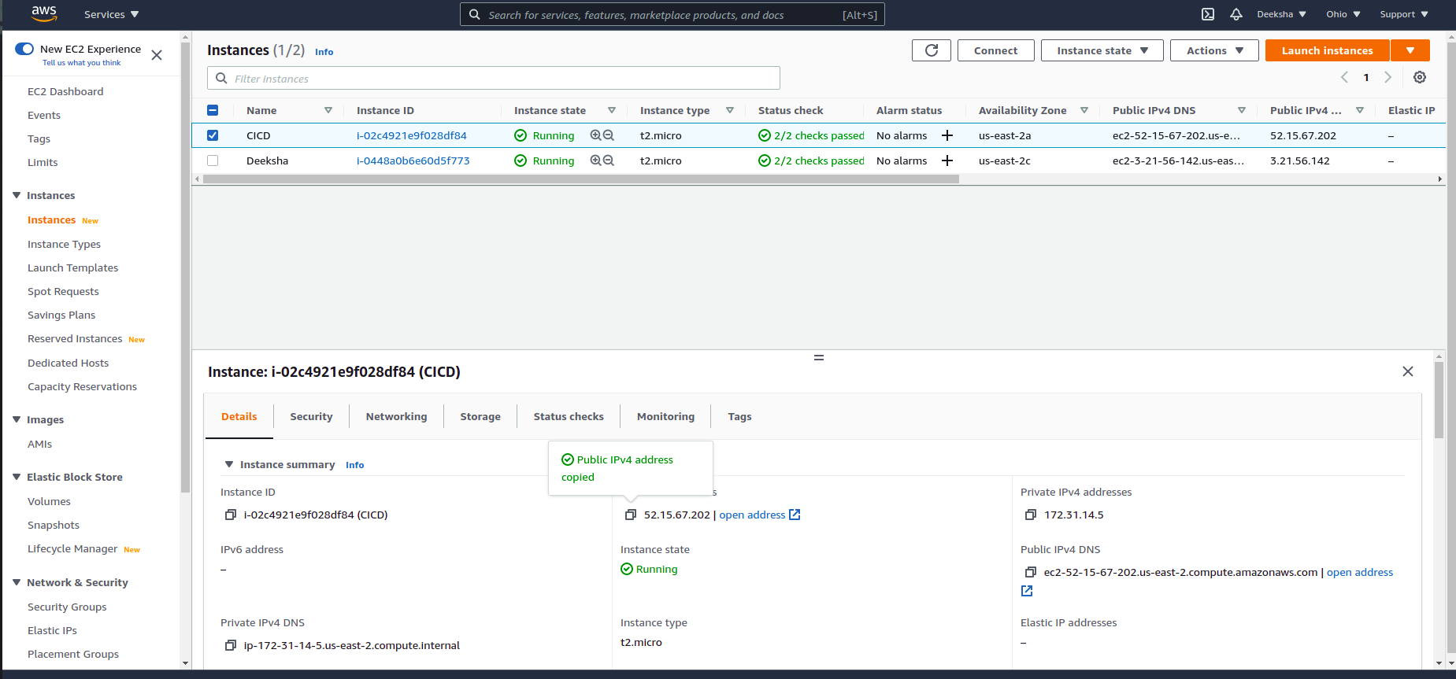
Create a Jenkins pipeline to deploy application present at: https://github.com/knoldus/node-hello and use any type of Jenkins project.
Creating an Instance at AWS Account

Slide 5
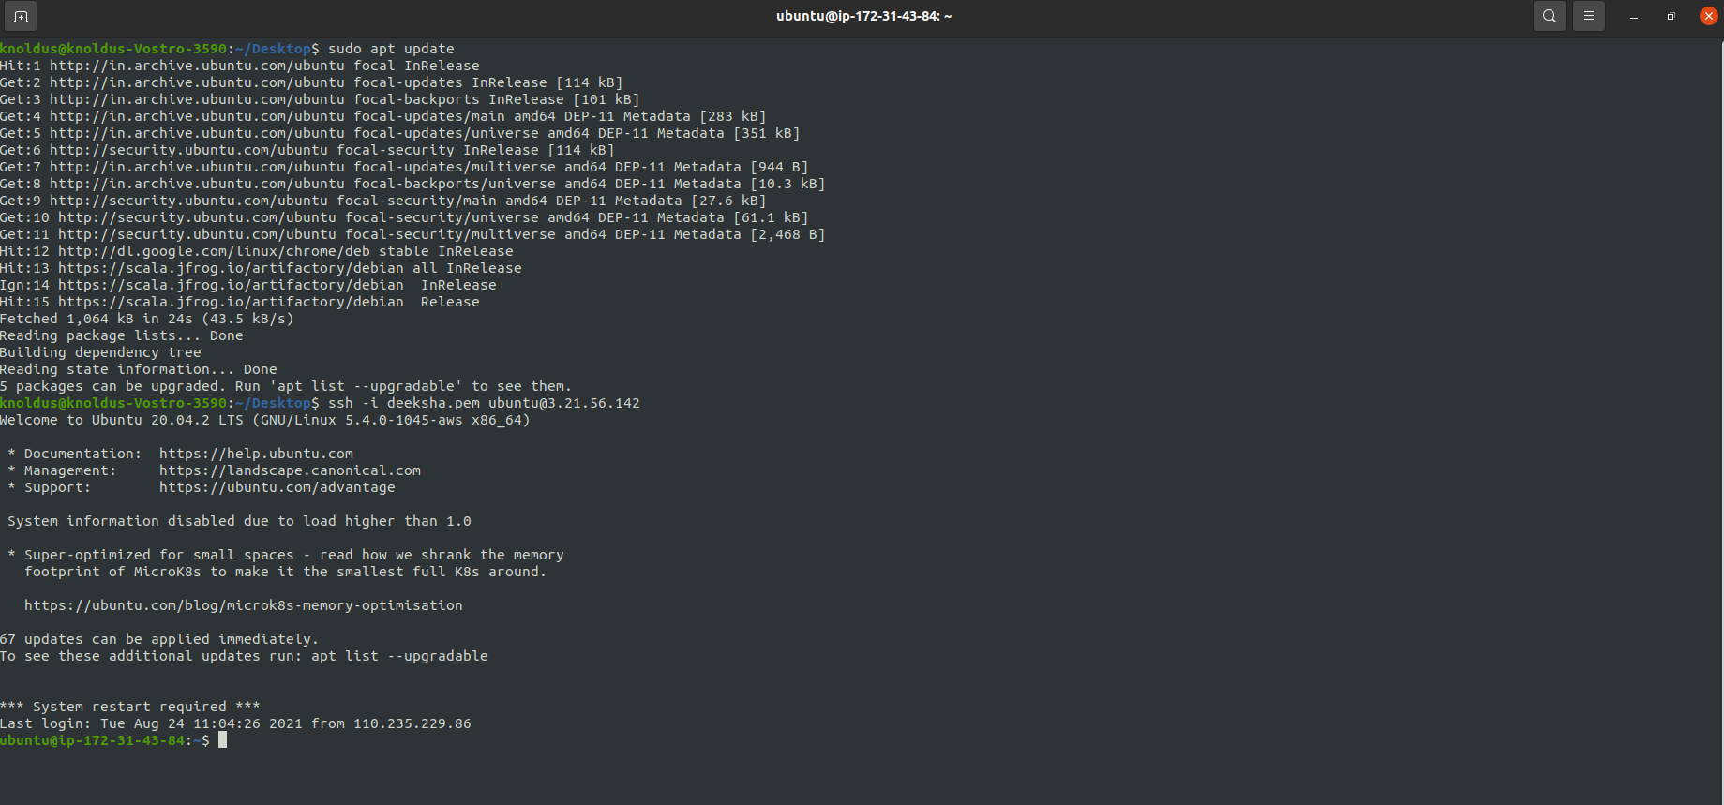
Create a Jenkins pipeline to deploy application present at: https://github.com/knoldus/node-hello and use any type of Jenkins project.
Accessing VM from the System
Accessing VM

Slide 6
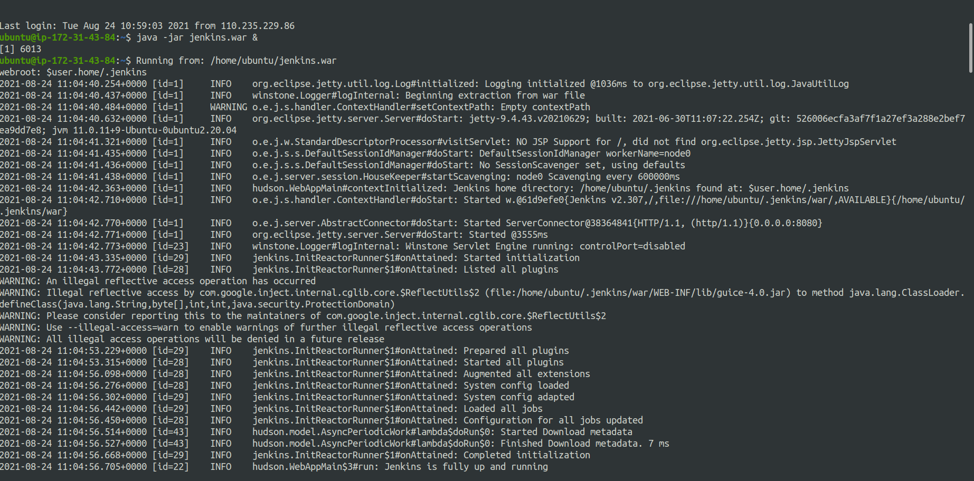
Create a Jenkins pipeline to deploy application present at: https://github.com/knoldus/node-hello and use any type of Jenkins project.
Running Jenkins in the Terminal
Running Jenkins

Slide 7
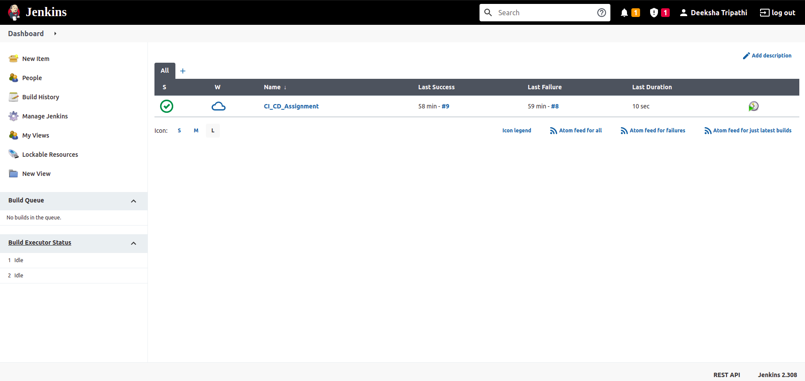

Create a Jenkins pipeline to deploy application present at: https://github.com/knoldus/node-hello and use any type of Jenkins project.
Creating new project on Jenkins
Creating New Project On Jenkins
Creating New Project On Jenkins

Slide 8
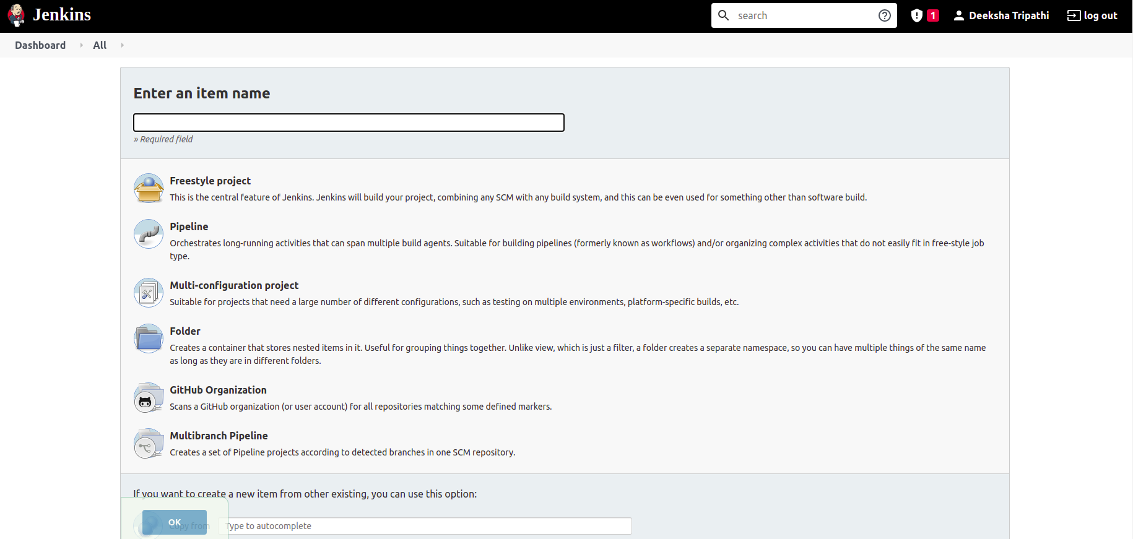
Create a Jenkins pipeline to deploy application present at: https://github.com/knoldus/node-hello and use any type of Jenkins project.
Enter the name of your project
Choose Freestyle project

Slide 9
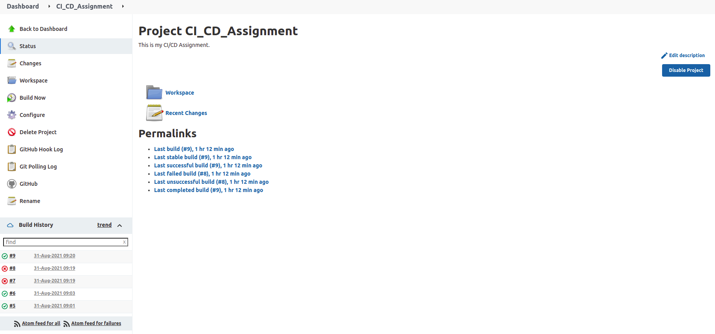
Required command to run the application and the ports being used are present in the Github repository.
Configuring the Jenkins Pipeline
Configuring the Jenkins Pipeline
Configuring the Jenkins Pipeline

Slide 10
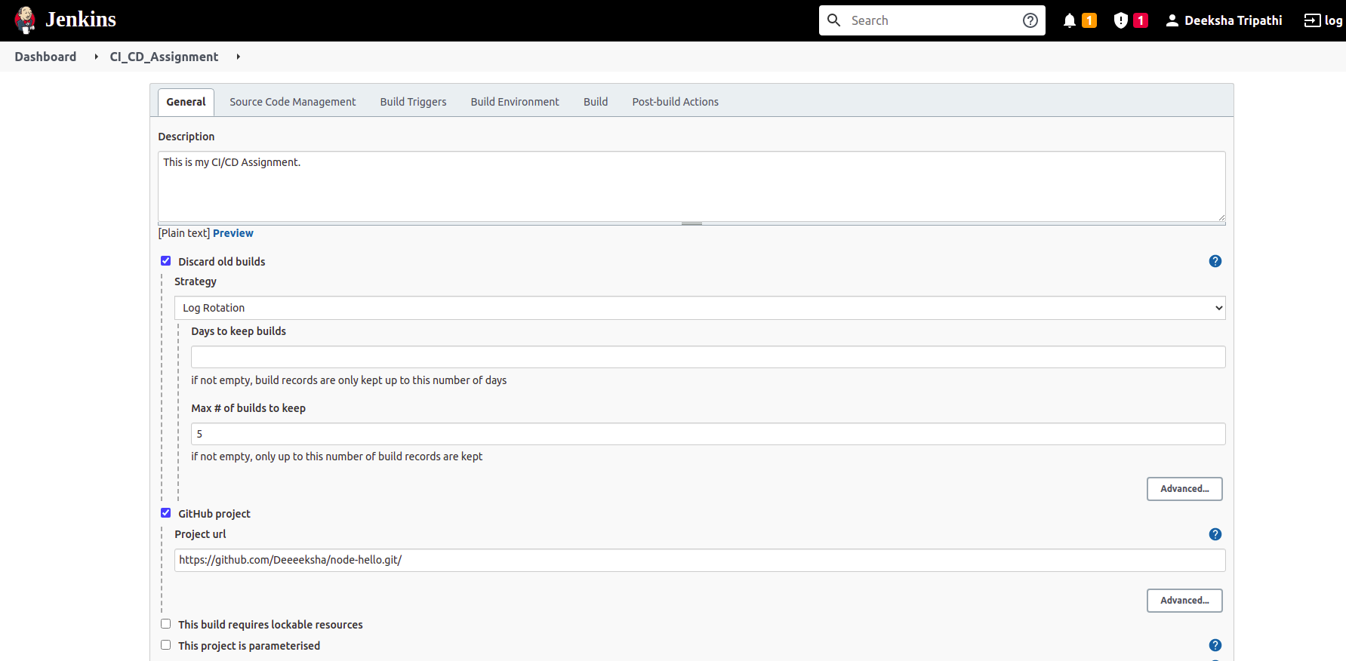
Required command to run the application and the ports being used are present in the Github repository.
Configuring Steps Of Jenkins

Slide 11
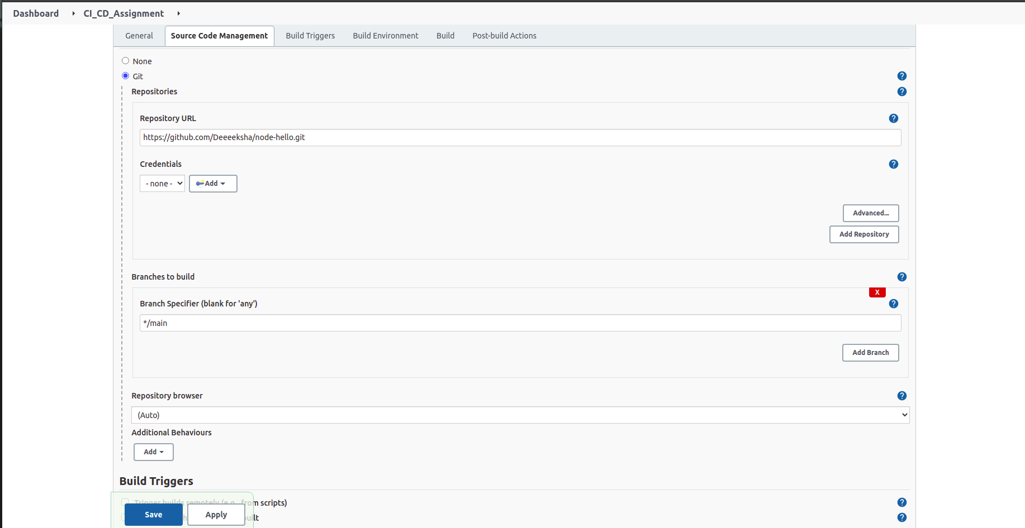
Required command to run the application and the ports being used are present in the Github repository.
Configuring Steps Of Jenkins

Slide 12
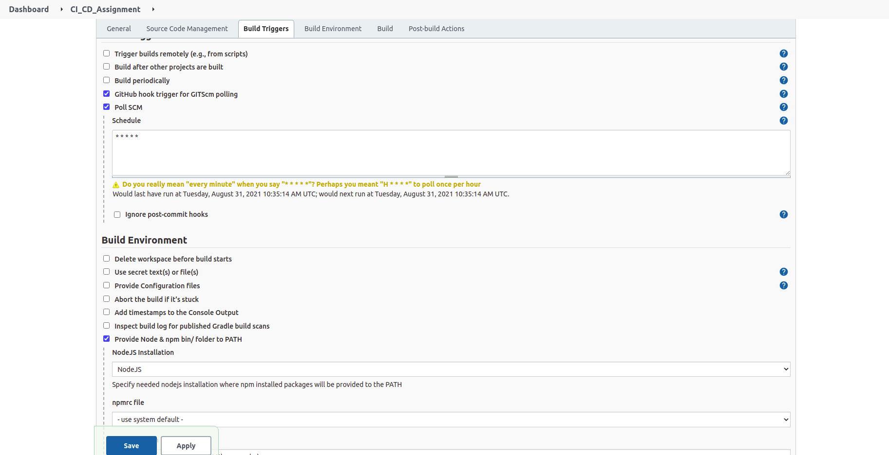
Required command to run the application and the ports being used are present in the Github repository.
Configuring Steps Of Jenkins

Slide 13
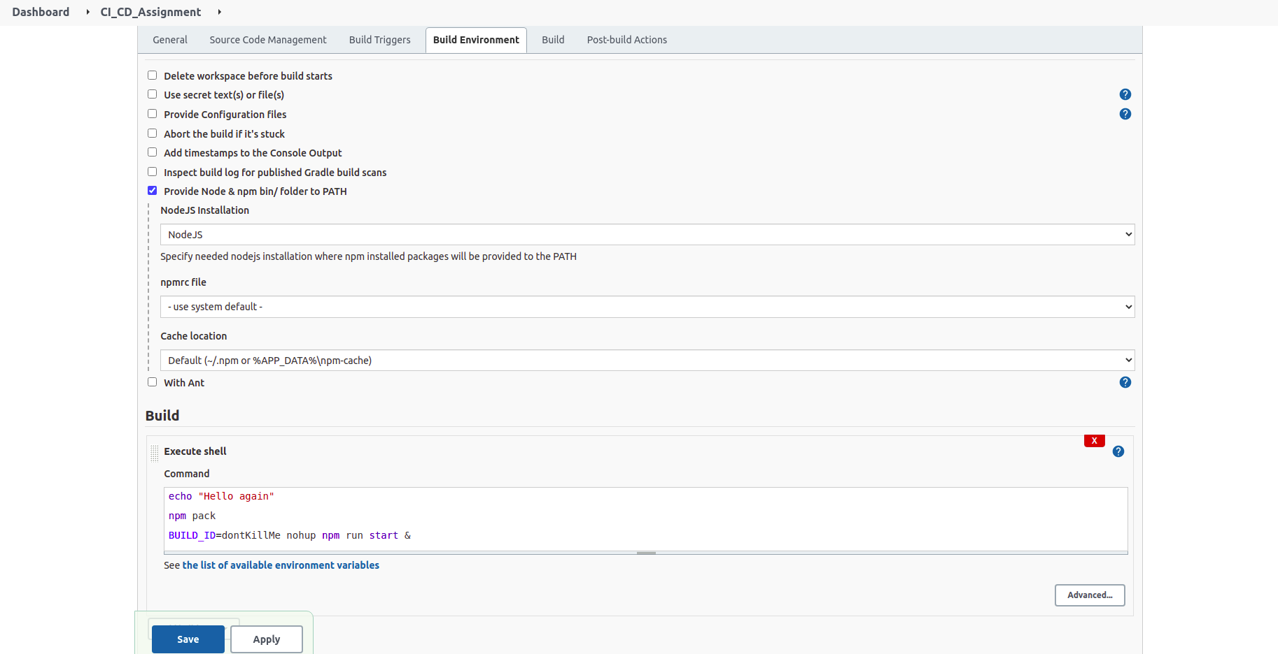
Required command to run the application and the ports being used are present in the Github repository.
Configuring Steps Of Jenkins

Slide 14
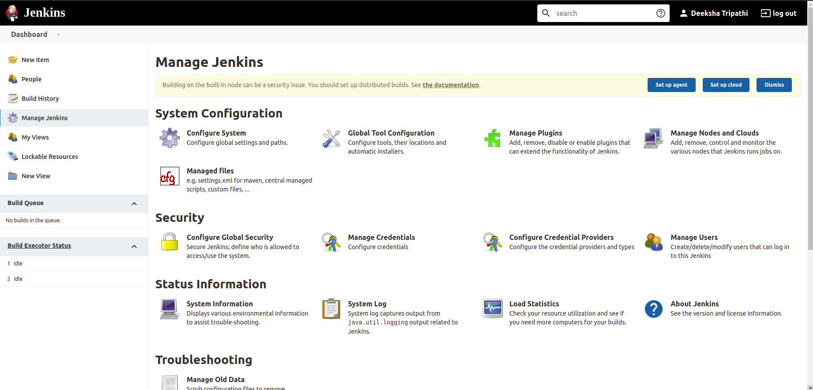
Required command to run the application and the ports being used are present in the Github repository.
Installing Jenkins Plugins
In Manage Jenkins Tab; Select Manage Plugins Option

Slide 15
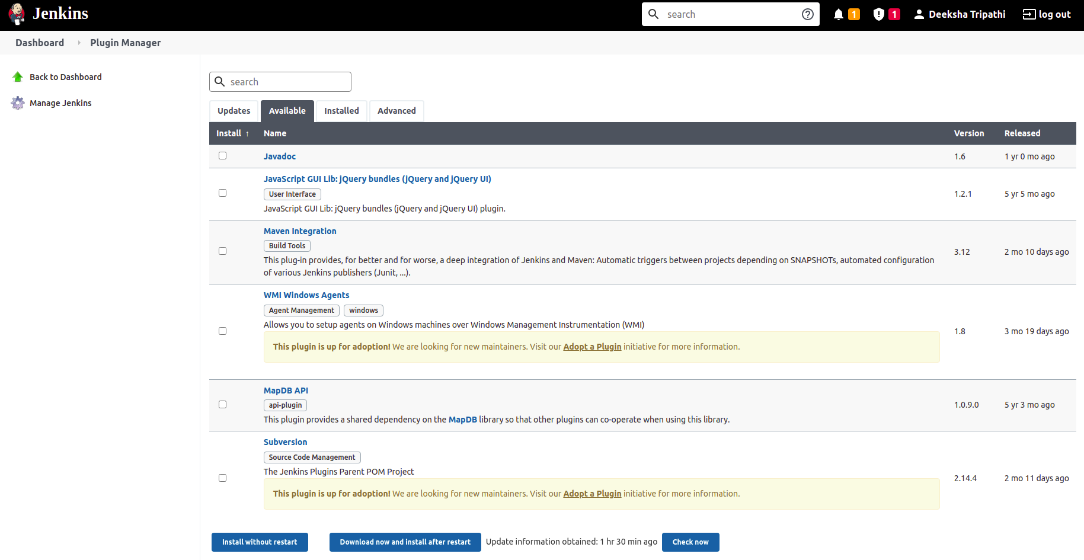
Required command to run the application and the ports being used are present in the Github repository.
Installing Jenkins Plugins
Select the Plugins need to be installed and install them like NodeJs & Docker

Slide 16
Required command to run the application and the ports being used are present in the Github repository.
Adding NodeJs in the Jenkins Pipeline

Slide 17
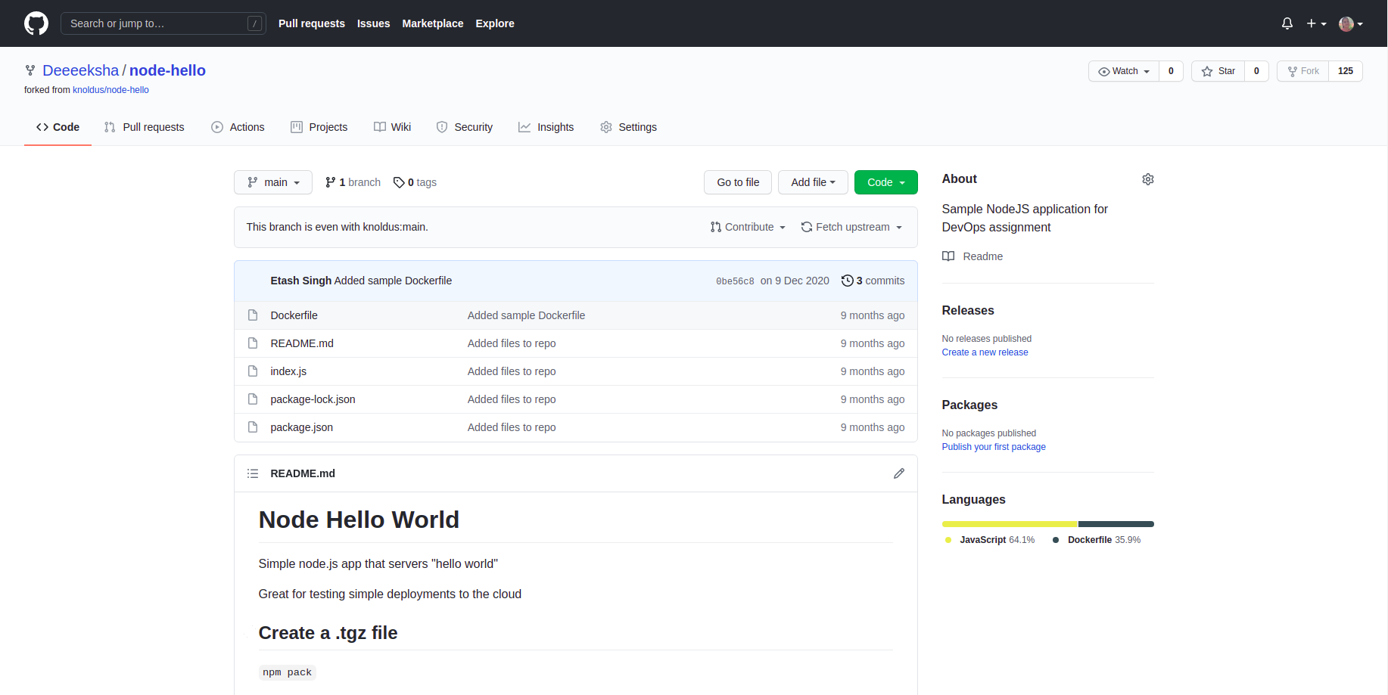
Required command to run the application and the ports being used are present in the Github repository.
Github Repository

Slide 18
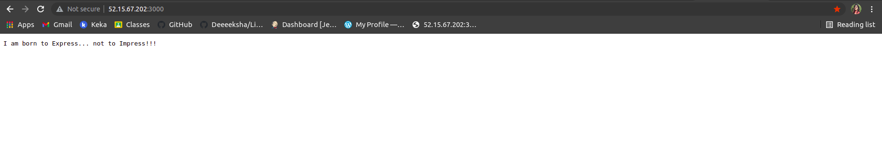
The validations can be performed by hitting endpoints: <VM_IP>:3000 or <VM_IP>:3001
Validation of <VM_IP>:3000 Port

Slide 19
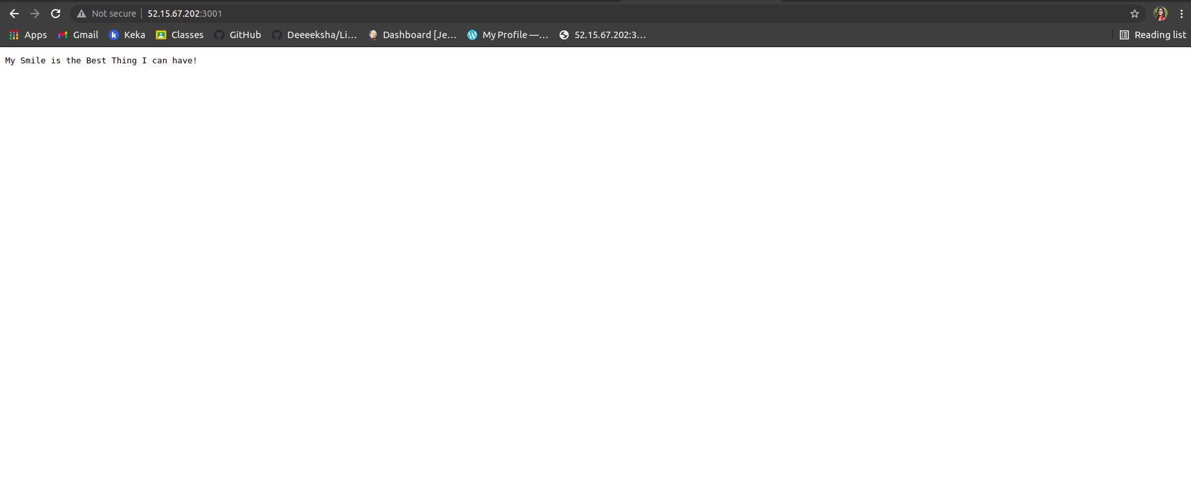
The validations can be performed by hitting endpoints: <VM_IP>:3000 or <VM_IP>:3001
Validation of <VM_IP>:3001 Port

Slide 20

Thank You!

